Slide 1
Opioid Antagonist Medication Saturation Plan
Breanne Van Dyne
Section Manager, State Opioid Response
Bureau of behavioral Health, Wellness and Prevention
SAB Advisory Board Bi-Monthly Meeting
April 24, 2024

Slide 2
Overview of the Plan
How’s Nevada Doing?
Opioid Antagonist Fund – Bulk Purchase Account
Expansion/Adaptation Plans
Questions

Slide 3
Overview: Opioid Antagonist Medication Saturation Plan
Published in 2022
Saturation Goal: opioid antagonist present at 80% of witnessed overdoses.
115,000 doses annually
Targeted distribution and communication strategy
Leverage partnerships
Goals and Activities:
Goal 1: Increase distribution locations serving high-risk populations
Goal 2: Enhance outreach and distribution to BIPOC populations
Goal 3: Support state litigation efforts to reduce barriers to naloxone access
Notes:
The plan was developed in 2022 in response to the escalating rates of opioid overdoses and deaths in Nevada, mirroring similar efforts across the United States to combat the opioid epidemic.
Like many other states, Nevada began experiencing a surge in opioid-related overdoses and deaths over the past few decades; July 1, 2021 – June 30, 2022 alone 420 witnessed fatal overdoses
Prescription opioid misuse, heroin use, and the proliferation of potent synthetic opioids like fentanyl contributed to the crisis.
Saturation Rate Goal:
The state aims for an 80% presence of opioid antagonist at witnessed overdoses, necessitating an annual distribution of 115,000 kits.
At the time of the Plan’s creation, ~28k kits distributed annually
Nevada plans infrastructure development to support distributing 50,000 kits per year over the next 2 years.
Targeted Distribution and Communication Strategy:
Leveraging data from SUDORS and Vital Death Records, Nevada identifies overdose hotspots and implements targeted strategies:
Strengthen industry partnerships, focusing on entertainment venues, jails, emergency rooms, and harm reduction vending machines.
Collaborate with the Attorney General’s Office to reduce access barriers through legislation.
Address disparities among Latinx and BIPOC populations through culturally appropriate outreach, community partnerships, and engagement with faith-based and minority health organizations.
Partnerships:
Nevada leverages partnerships with various entities including
CASAT, who as a subrecipient of SOR funding, has played an enormous role in community training and distribution.
Attorney General’s Office
Fund for a Resilient Nevada
Minority Health Equity Coalition
Medicaid,
prevention coalitions,
tribal consultation groups,
and OD2A for surveillance and targeting efforts.
Goals and Activities:
Goal 1: Increase distribution locations serving high-risk populations through activities like expanding distribution sites in criminal justice settings and entertainment industries.
Goal 2: Enhance outreach and distribution to BIPOC populations by producing translated materials, increasing mutual aid and coalition distribution locations, engaging faith-based organizations, and distributing through labor associations.
Goal 3: Support state litigation efforts to reduce barriers to naloxone access by aiding the Attorney General’s office with data, networking, and technical assistance.

Slide 4
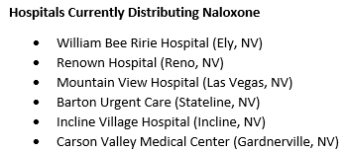
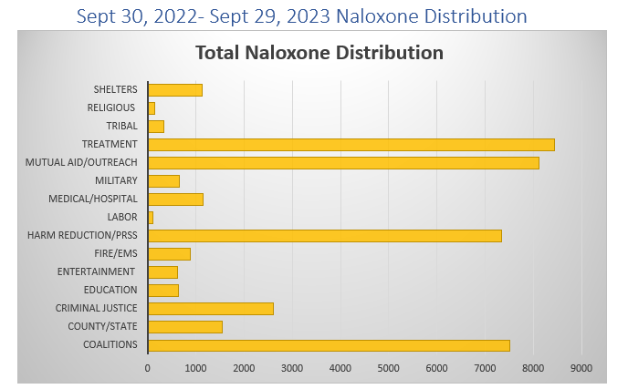
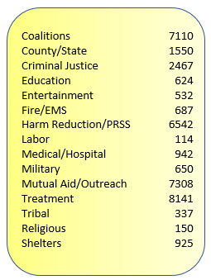
How’s Nevada Doing?
UNR CASAT – Distribution Site for most naloxone purchased at the State level
Notes:
*does not include doses distributed by SNHD

Slide 5
Opioid Antagonist Fund – Bulk Purchase Account
Established by Assembly Bill 156 during the 2023 Nevada Legislative Session
Solely designated for purchasing opioid antagonists and associated distribution costs
The Division can receive funds from various sources
Exempt from the State Budget Act
A system will be created to track incoming requests and outgoing orders
Aligns with Opioid Antagonist Saturation Plan
Notes:
Established last leg. Session
Only for the purpose of paying for the distribution and purchasing of opioid antagonists
Removes the red tape that can delay getting opioid antagonists out into the hands of Nevadans
BBHWP will hire staff to oversee the fund, update saturation plan, and develop a system for tracking
Supports the Plan’s goal of having an opioid antagonist present at 80% of witnessed overdoses

Slide 6
Plans for Expansion/Adaptation
Evolving opioid trends, emerging challenges, and feedback from stakeholders will inform updates to the Plan.
May incorporate more opioid antagonists in the future
Ex: Nalmafene (Opvee) and 8 mg naloxone (Kloxxado)
Community partner survey forthcoming
Notes:
Over time, Nevada’s Opioid Antagonist Medication Saturation Plan may undergo expansions or adaptations in response to evolving opioid trends, emerging challenges, and feedback from stakeholders.
Continuous evaluation and refinement are critical to ensuring that the plan remains effective in addressing the state's opioid crisis.
Survey for community stakeholders is being finalized now to garner feedback re: adding more opioid antagonist medications to the plan and state-funded stock of O.A.s
Incorporating a variety of opioid antagonists into a state saturation plan can provide multiple options for preventing and treating opioid overdoses, addressing opioid dependence, and improving overall public health outcomes related to opioid misuse and addiction. By expanding access to these medications, along with appropriate training and support services, states can enhance their efforts to combat the opioid epidemic and save lives.

Slide 8
Breanne Van Dyne
Section Manager, Nevada State Opioid Response
Bureau of Behavioral Health Wellness and Prevention
bvandyne@health.nv.gov

